Slide 1
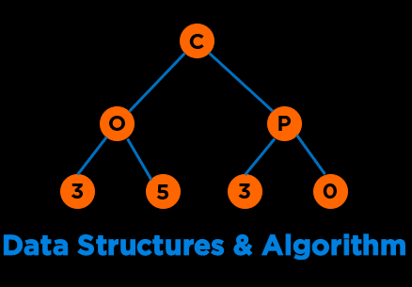
Data Structures & Algorithms
COP 3530 : Fall 2026

Slide 2












About Me: Amanpreet Kapoor
  Educator
  CS Education Researcher
  Mentor
  Software Engineer
  Lifelong Learner
kapooramanpreet@ufl.edu
Notes:
My name is Aman and I will be your instructor for this course
I wear many hats and identify myself as a
Some of the organ…

Slide 3
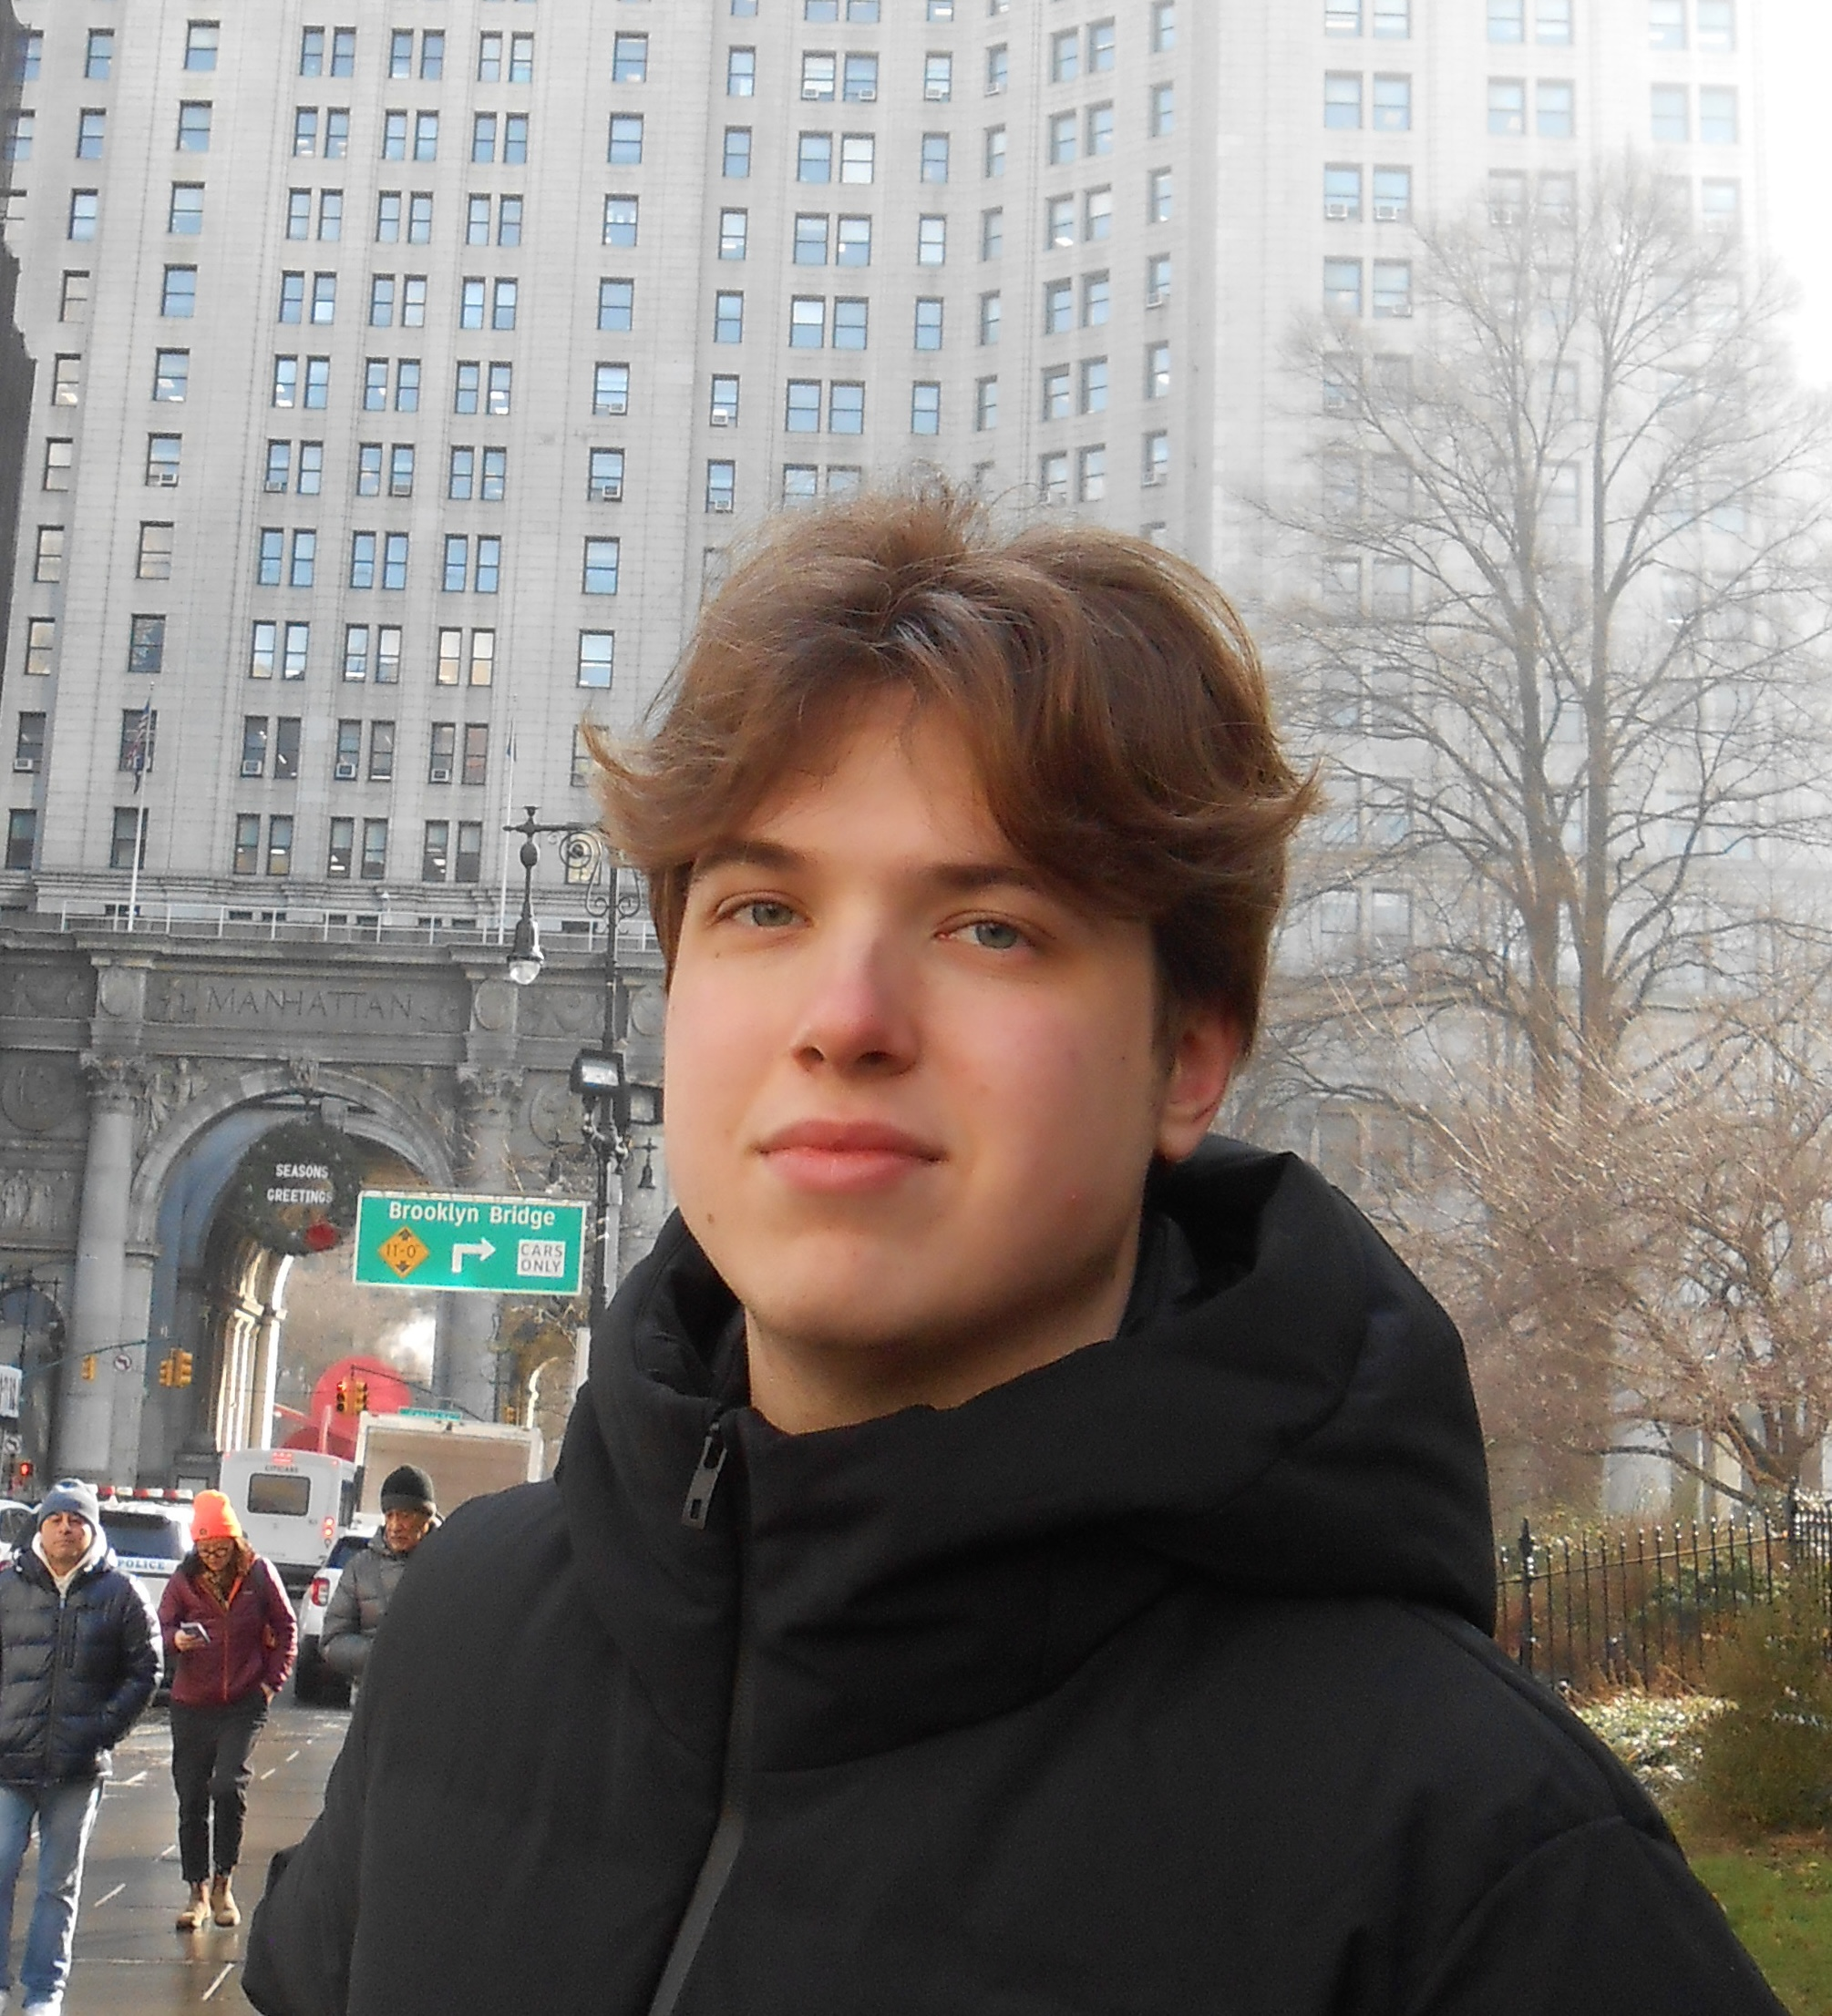
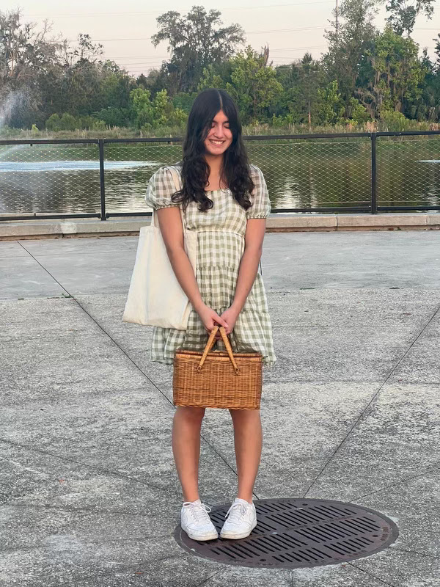
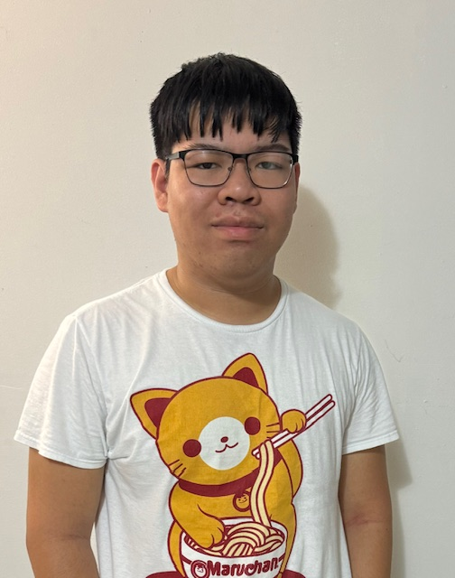
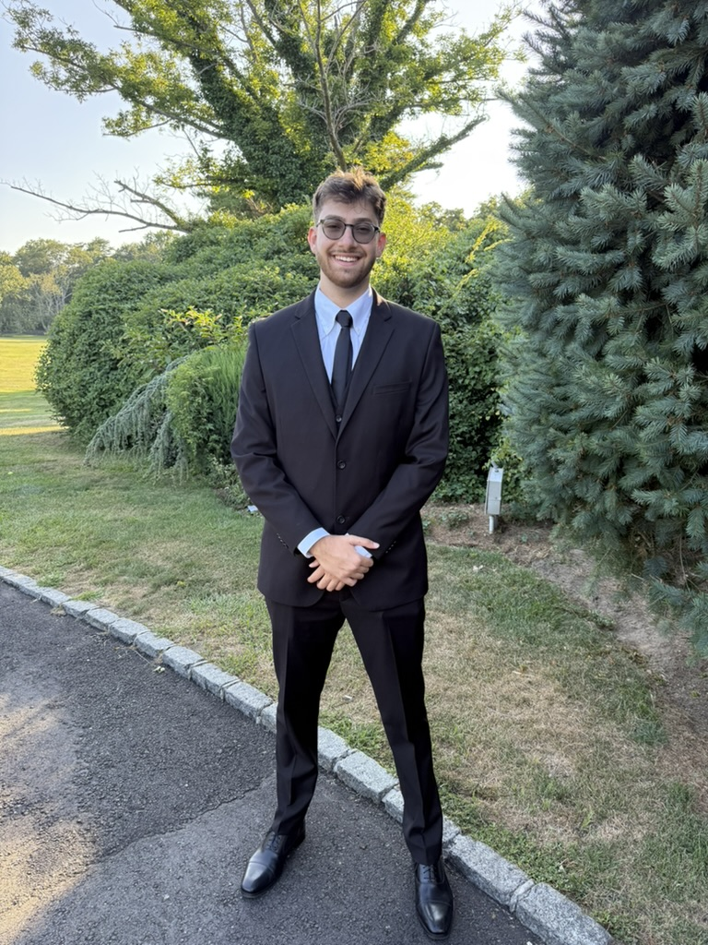
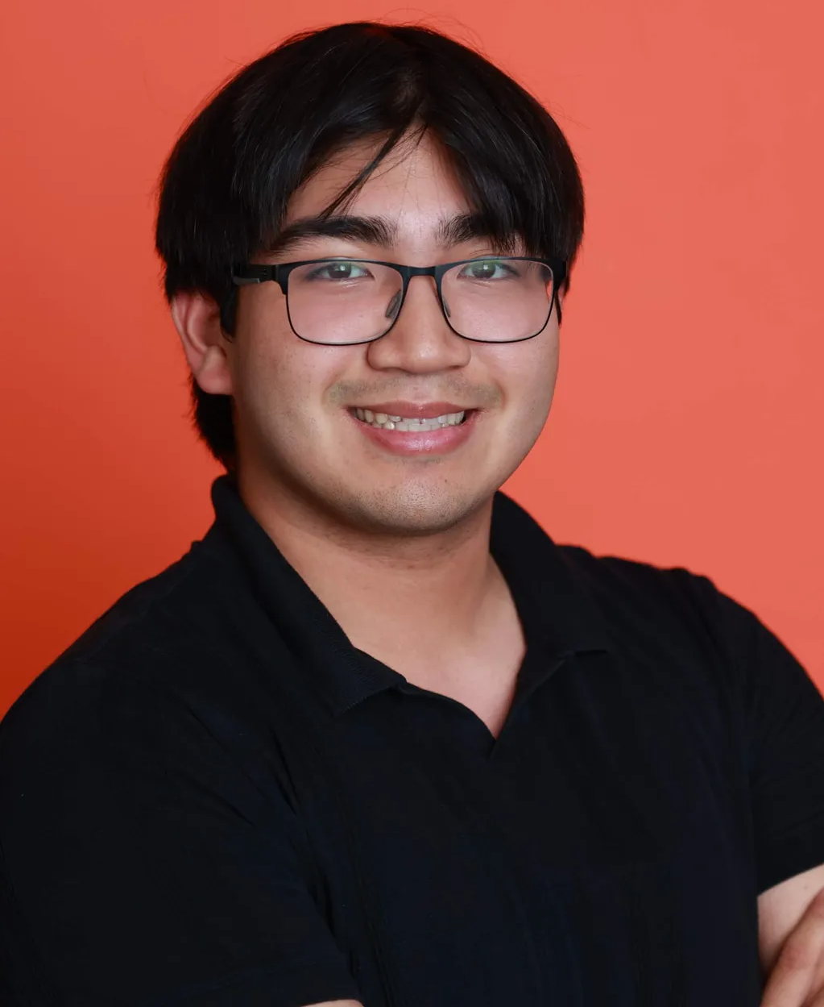
Course Staff
Cole
(Head TA & Lead - Teaching)
Emma
Jackie
(Lead - Communications)
Josh
(Co-lead Infra)
Adrian
(Lead Content)

Slide 4
Learners: Let’s Get to Know You
Go To Menti.com
Code: 3655 6919

Slide 5
Course Objectives

Slide 6
What is this Course About?
This course covers algorithm development using
  pseudo languages
  basic program structures
  program design techniques
  storage and manipulation of basic data structures
  3 Credit Hours

Slide 7
What is this Course About?
Data Structures & Algorithms
Conceptual Understanding
Critical Thinking or Problem Solving
Implementation
Notes:
Psuedocode and code

Slide 8

Categories of Data Structures
Linear Ordered
Non-linear Ordered
Not Ordered
Lists
Trees
Sets
Stacks
Graphs
Tables/Maps
Queues
Notes:
Data structures are ways to collect data. There are basic categories of data structures:

Slide 9

Categories of Algorithms
Brute Force
Divide & Conquer
Greedy
Dynamic Programming
Selection Sort
Binary Search
Minimum Spanning Tree
Knapsack
Bubble Sort
Merge Sort
Shortest Paths
Fibonacci
Insertion Sort
Quick Sort
NP Complete Problems
Notes:
We will be talking about various DS and Algo

Slide 10
Logistics & Policies
Notes:
But what do we truly care about?

Slide 11



Format
Action Items by Monday morning
Watch lectures synchronously on Tue and Thu in person or live via Zoom.
Conceptual Quiz due on Fri.
Programming Quiz due on Fri.
Attend discussions on Wed.

Slide 12

Communication
Slack
Office Hours
Everything!
– for all question related to the course
– for communicating with peers
- one-to-one communication with me
Use Appropriate Tags
Response in < 48 business hours
Thursday, 4:05 – 6 pm
By Appointment (24 hours in advance)

Slide 13
Communication
Email
Email
Fine for
Personal
Accommodations
Emergencies
Not okay for
Questions regarding logistics
Questions on coding
Fixing bugs

Slide 14

Communication
Canvas Messages
Phone Call

Slide 15
Debugging
Students should visit the course staff during scheduled office hours for help and provide context for help.
Debugging requests for projects/quiz questions must first go through the TAs or peer mentors. This is strongly encouraged given we have a large class and several of you might have similar questions.
If your problem is not fixed, then start a conversation with both the Instructor and the TA/Peer mentor who you asked for help. Debugging requests to the Instructor as a Slack direct message or an email will be ignored if you do not follow the above protocol.

Slide 16
Grading
Modality | Assignment | % of Final Grade
Individual | Programming / HTG Quizzes (drop two lowest scores) | 6%
 | Conceptual quizzes (drop two lowest scores) | 6%
 | Exam 1 | 25%
 | Exam 2 | 25%
 | Project 1 | 12%
 | Project 3 | 12%
 | Class and discussion participation (drop four lowest scores) | 4%
Collaborative | Project 2 (Individual or Group: 2a & 2b) | 10%
Individual | Extra Credit Opportunities | Up to 2%
 |  | Total: 102%
Total assessments: 26 excluding extra credit and class/discussion participation

Slide 17
Timeline
Week | Dates |  | Topic | Deadlines
1 | 20-Aug | 23-Aug | Course Introduction/Algorithm Analysis
2 | 24-Aug | 30-Aug | Algorithm Analysis / List | Q₁
3 | 31-Aug | 6-Sep | Stacks, & Queues / Trees | Q₂
4 | 7-Sep | 13-Sep | Trees / Balanced Trees 1 | Q₃
5 | 14-Sep | 20-Sep | Balanced Trees 2 | Q₄
6 | 21-Sep | 27-Sep | Heaps & Priority Queues | P₁
7 | 28-Sep | 4-Oct | Sorting | Q₅
8 | 5-Oct | 11-Oct | Exam 1 (Oct 6 - 8:20 - 10:10 PM) | E₁, P_{2a}
9 | 12-Oct | 18-Oct | Sets, Maps, & Hashing | Q₆
10 | 19-Oct | 25-Oct | Graphs 1 | Q₇
11 | 26-Oct | 1-Nov | Graphs 2 | Q₈
12 | 2-Nov | 8-Nov | Greedy Algorithms | P_{2b}
13 | 9-Nov | 15-Nov | Dynamic Programming | Q₉
14 | 16-Nov | 22-Nov | Exam 2 (Nov 18 - 8:20 - 10:10 PM) | E₂
15 | 23-Nov | 29-Nov | Thanksgiving Break
16 | 30-Nov | 2-Dec | Complexity Theory | Q₁₀, P₃
Legend: Q_{N} = Quiz N, P_{N} = Project N, E_{N} = Exam N

Slide 18
Programming Language
Default (Project 1 & 3, Edugator, Quizzes):
    C++14
Project 2:
    Any Language
Compilation command:
g++ -std=c++14 -Werror -Wuninitialized -o EXECUTABLE_NAME YOUR_FILE.cpp

Slide 19


Tools
Compiler
  G++
  Edugator/Gradescope
IDE
  OnlineGDB
  Visual Studio Code
  Clion
Notes:
Why Stepik: you wont have access top an ide and previously students said that it helps; iT wont get you a job but it will help you develop confidence

Slide 20
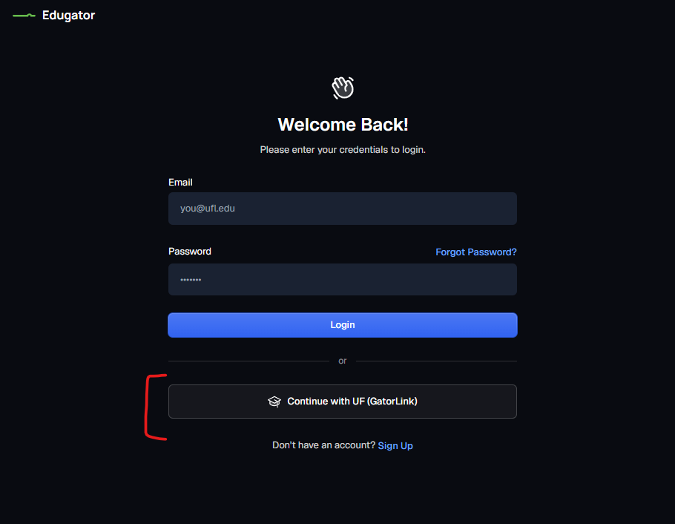
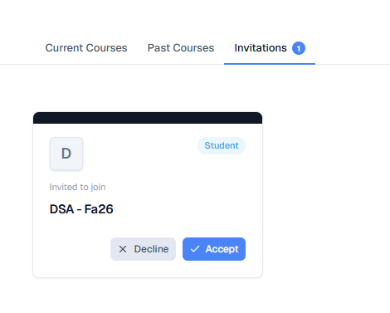
Tools
Edugator
We will be using Edugator (https://edugator.app/), a platform similar to technical interview and programming practice websites such as LeetCode. Edugator provides an organized environment where you can complete programming practice problems and keep track of your progress. You will also have access to Bloom, Edugator’s 24/7 AI tutor, which you can use to ask questions and get help while working through problems. The cost of access is $8 for one year for this course.
How to Enroll in Edugator
1. Go to https://edugator.app/sign-in
2. Click Continue with UF (GatorLink).
3. Go to the Invitations tab and click Accept for the course invitation.
4. Pay the $8 access fee. Once payment is complete, you will have access to the course shell for one year.
If you experience any difficulties, contact support@edugator.app
Notes:
Why Stepik: you wont have access top an ide and previously students said that it helps; iT wont get you a job but it will help you develop confidence

Slide 21
Tools
Directory Structures
  src – includes .h and .cpp files
  (You can use lib/ too for separating interfaces - .h)
  test – contains test files
  build – contains executables (e.g. .exe)
  Know basic commands on compilation through command line:
    cd, ls, mv, g++, pwd …
https://cplusplus.com/forum/beginner/261697
https://stackoverflow.com/questions/2360734/whats-a-good-directory-structure-for-larger-c-projects-using-makefile
Notes:
Why Stepik: you wont have access top an ide and previously students said that it helps; iT wont get you a job but it will help you develop confidence

Slide 22
Textbook (Optional)
Data Structures and Algorithm Analysis in C++
  Mark Allen Weiss
  Fourth edition, 2014, ISBN 9780132847377
OpenDSA Book
  https://opendsa-server.cs.vt.edu/OpenDSA/Books/Everything/html/index.html

Slide 23
Feedback
COP 3530 Feedback Form
Bug Bounty Program
  Quiz is not accessible due to a locked module
  Typo in one of the quizzes/project descriptions
  Incorrect solution in a certain test case
  An accessibility bug such as no headings in documents for screen-readers
  the algorithm has an off-by-one error

Slide 24
Expectations
We want you to focus on
  Correctness
  Clean, readable, tested, and documented code
  Secondary focus on optimization
The course will not cover
  Mathematical Proofs
  Design Patterns
  Competitive Programming

Slide 25
Expectations
Conceptual Quizzes and Exams:
Work independently
No discussion at the conceptual level
You are allowed to
  discuss solutions after the due date and late days have passed.

Slide 26
Expectations
Programming Quiz questions:
Work independently or as a pair (Select a buddy in Week 1).
The buddy must remain the same for the entire course.
The course staff can help you on syntax issues, but we will not help you with semantic and logic issues for quizzes.
Cite that you worked with a buddy in Line 1 of your code and add their name.
You are allowed to
  discuss solutions after the due date and late days have passed.
  search for C++ syntax or refer to definitions of standard functions in the C++ library. For example, using the documentation listed here is fine: https://www.cplusplus.com/reference/ or https://en.cppreference.com/w/

Slide 27
Academic Dishonesty
Project 1 and 3:
Work independently
Discussion at the conceptual level is fine if you are stuck with no sharing/viewing of code
You are allowed to
  discuss conceptually without discussing any code with a peer provided you cite the peer with who you discussed it. Such discussions should be held on a whiteboard using explanation figures/pseudo-codes or through talking.
  discuss solutions after the due date and late days have passed.
  search for C++ syntax or refer to definitions of standard functions in the C++ library. For example, using the documentation listed here is fine: https://www.cplusplus.com/reference/ or https://en.cppreference.com/w/

Slide 28
Academic Dishonesty
Project 2 and Edugator ungraded questions:
It is fine to collaborate with peers. You must make sure you are not blindly copy-pasting another student’s code. Also, you must cite the peer you worked with at the code level or conceptually.

Slide 29
Academic Dishonesty and GenAI policy
Sharing, copying, “borrowing” code, viewing another student’s work, or plagiarism of any form is academic dishonesty. You may not view or share external code, search for solutions online, use genAI tools such as ChatGPT to generate entire functions/programs, use AI tools to write/translate reports, or have someone else complete your work.
AI tools may be used for learning concepts or subtasks, but not to produce solutions for quizzes, exams, or projects. If GenAI tools are used for learning, you must cite the tool, model, and prompt.
Penalty
  reported to the Honor Court
  E grade for the course
Regret Clause:
  If you submit an assignment, in which you engaged in some of the unacceptable practices, you may bring it to my attention by emailing me and withdrawing your assignment within 48 hours of the submission. If you do so, I will assign a failing grade of 0 for the assignment, and you will not be reported to the administration.

Slide 30
Request for Extensions
Any request for assessment extensions should be backed by official documentation (e.g., from a medical professional, etc.) and should be sent over email. Requests without documentation will be ignored. The following reasons deem ineligibility for extensions or regrades:
  Failure to submit on Canvas by due date/late date. Example: If a quiz is due at 11:59 pm, and you send the file at 12:01 am, the file will not be graded. Note that most assessments are open for 4 or more days and you must start early and submit it on time. In case you miss an assignment, treat it as a learning activity and avoid that in the future.
  Forgetting to turn in an assessment on time.
  File naming issues or feedback issues on projects. Gradescope gives you feedback and please read it and fix your file and resubmit. Note that you have unlimited attempts on Gradescope for everything and we will not grade your files if you do not adhere to instructions on file submissions and/or if the Gradescope scores your file to 0. It is your responsibility to read the feedback and fix your code. In case you miss reading the feedback, treat it as a learning activity and avoid that in the future.

Slide 31
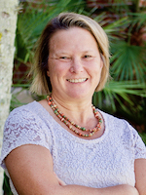
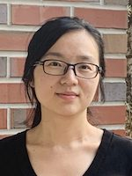
Acknowledgements
Cheryl Resch
Lecturer,
Dept. of Engineering Education,
University of Florida
Lisha Zhou
Lecturer,
Dept. of Engineering Education,
University of Florida

Slide 32
References
Books/Notes
  Dr. Sartaj Sahni
  Dr. James Aspen
  Dr. Mark Weiss
  Dr. Clifford Shaffer
  OpenDSA
  Dr. Cathy Hughes
Videos Authority
  Dr. Josh Hug
  MIT OCW 6.006: Dr. Erik Demaine and Dr. Srini Devadas
  Dr. Robert Sedgewick
Videos Youtube
  HackerRank: Data Structures
  HackerRank: Algorithms
  Back To Back SWE
  MyCodeSchool
  Abdul Bari
GeeksforGeeks

Slide 33
Walkthrough

Slide 34
Walkthrough
Canvas
OpenDSA
Slack
Edugator
Gradescope

Slide 35
Questions

